Slide 1
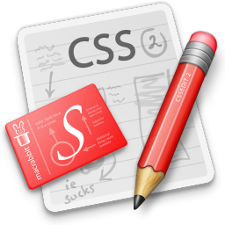

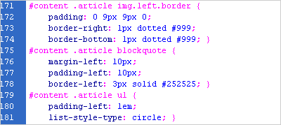
Cascading Style Sheets (CSS) – Part II
Svetlin Nakov
Telerik Corporation
www.telerik.com

Slide 2
Table of Contents (Part II)
The Box Model
Alignment, Z-Index, Margin, Padding
Positioning and Floating Elements
Visibility, Display, Overflow
CSS Development Tools

Slide 3
Width and Height
width – defines numerical value for the width of element, e.g. 200px
height – defines numerical value for the height of element, e.g. 100px
By default the height of an element is defined by its content
Inline elements do not apply height, unless you change their display style.

Slide 4
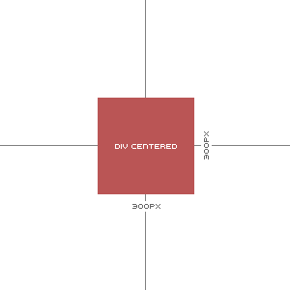
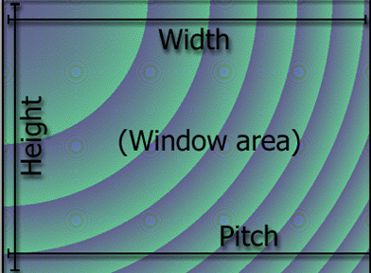
Width / Height
Live Demo
size-rules.html

Slide 5
Margin and Padding
margin and padding define the spacing around the element
Numerical value, e.g. 10px or -5px
Can be defined for each of the four sides separately - margin-top, padding-left, …
margin is the spacing outside of the border
padding is the spacing between the border and the content
What are collapsing margins?

Slide 6
Margin and Padding: Short Rules
margin: 5px;
Sets all four sides to have margin of 5 px;
margin: 10px 20px;
top and bottom to 10px, left and right to 20px;
margin: 5px 3px 8px;
top 5px, left/right 3px, bottom 8px
margin: 1px 3px 5px 7px;
top, right, bottom, left (clockwise from top)
Same for padding

Slide 7

Margins and Paddings
Live Demo
margins-paddings-rules.html

Slide 8
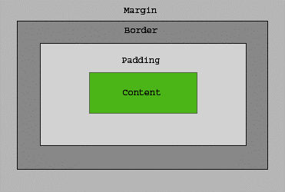
The Box Model

Slide 9
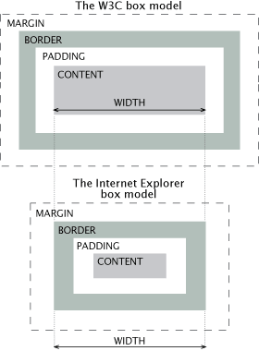
IE Quirks Mode
When using quirks mode (pages with no DOCTYPE or with a HTML 4 Transitional DOCTYPE), Internet Explorer violates the box model standard

Slide 10
Positioning
position: defines the positioning of the element in the page content flow
The value is one of:
static (default)
relative – relative position according to where the element would appear with static position
absolute – position according to the innermost positioned parent element
fixed – same as absolute, but ignores page scrolling

Slide 11
Positioning (2)
Margin VS relative positioning
Fixed and absolutely positioned elements do not influence the page normal flow and usually stay on top of other elements
Their position and size is ignored when calculating the size of parent element or position of surrounding elements
Overlaid according to their z-index
Inline fixed or absolutely positioned elements can apply height like block-level elements

Slide 12
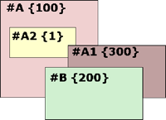
Positioning (3)
top, left, bottom, right: specifies offset of absolute/fixed/relative positioned element as numerical values
z-index : specifies the stack level of positioned elements
Understanding stacking context
Each positioned element creates a stacking context.
Elements in different stacking contexts are overlapped according to the stacking order of their containers. For example, there is no way for #A1 and #A2 (children of #A) to be placed over #B without increasing the z-index of #A.

Slide 13


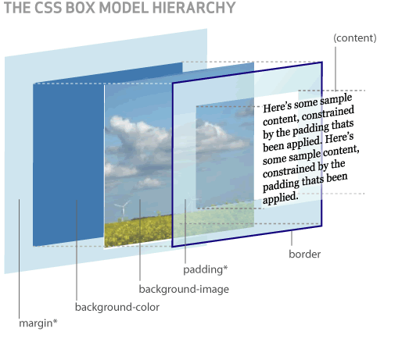
Positioning
Live Demo
positioning-rules.html

Slide 14
Inline element positioning
vertical-align: sets the vertical-alignment of an inline element, according to the line height
Values: baseline, sub, super, top, text-top, middle, bottom, text-bottom or numeric
Also used for content of table cells (which apply middle alignment by default)

Slide 15
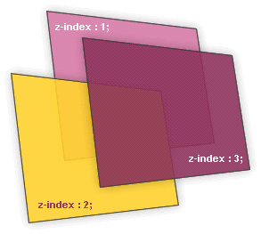

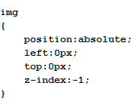
Alignment and Z-Index
Live Demo
alignments-and-z-index-rules.html

Slide 16
Float
float: the element “floats” to one side
left: places the element on the left and following content on the right
right: places the element on the right and following content on the left
floated elements should come before the content that will wrap around them in the code
margins of floated elements do not collapse
floated inline elements can apply height

Slide 17
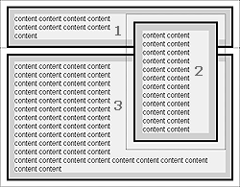
Float (2)
How floated elements are positioned

Slide 18
Clear
clear
Sets the sides of the element where other floating elements are NOT allowed
Used to "drop" elements below floated ones or expand a container, which contains only floated children
Possible values: left, right, both
Clearing floats
additional element (<div>) with a clear style

Slide 19
Clear (2)
Clearing floats (continued)
:after { content: ""; display: block; clear: both; height: 0; }
Triggering hasLayout in IE expands a container of floated elements
display: inline-block;
zoom: 1;

Slide 20


Floating Elements
Live Demo
float-rules.html

Slide 21
Opacity
opacity: specifies the opacity of the element
Floating point number from 0 to 1
For old Mozilla browsers use –moz-opacity
For IE use filter:alpha(opacity=value) where value is from 0 to 100; also, "binary and script behaviors" must be enabled and hasLayout must be triggered, e.g. with zoom:1

Slide 22
Opacity
Live Demo
opacity-rule.html

Slide 23
Visibility
visibility
Determines whether the element is visible
hidden: element is not rendered, but still occupies place on the page (similar to opacity:0)
visible: element is rendered normally

Slide 24
Visibility
Live Demo
visibility-rule.html

Slide 25
Display
display: controls the display of the element and the way it is rendered and if breaks should be placed before and after the element
inline: no breaks are placed before and after (<span> is an inline element)
block: breaks are placed before AND after the element (<div> is a block element)

Slide 26
Display (2)
display: controls the display of the element and the way it is rendered and if breaks should be placed before and after the element
none: element is hidden and its dimensions are not used to calculate the surrounding elements rendering (differs from visibility: hidden!)
There are some more possible values, but not all browsers support them
Specific displays like table-cell and table-row

Slide 27

Display
Live Demo
display-rule.html

Slide 28
Overflow
overflow: defines the behavior of element when content needs more space than you have specified by the size properties or for other reasons. Values:
visible (default) – content spills out of the element
auto - show scrollbars if needed
scroll – always show scrollbars
hidden – any content that cannot fit is clipped

Slide 29
Overflow
Live Demo
overflow-rule.html

Slide 30
Other CSS Properties
cursor: specifies the look of the mouse cursor when placed over the element
Values: crosshair, help, pointer, progress, move, hair, col-resize, row-resize, text, wait, copy, drop, and others
white-space – controls the line breaking of text. Value is one of:
nowrap – keeps the text on one line
normal (default) – browser decides whether to brake the lines if needed

Slide 31
Benefits of using CSS
More powerful formatting than using presentation tags
Your pages load faster, because browsers cache the .css files
Increased accessibility, because rules can be defined according given media
Pages are easier to maintain and update

Slide 32
Maintenance Example
Title
Some random text here. You can’t read it anyway! Har har har! Use Css.
Title
Some random text here. You can’t read it anyway! Har har har! Use Css.
Title
Some random text here. You can’t read it anyway! Har har har! Use Css.
Title
Some random text here. You can’t read it anyway! Har har har! Use Css.
Title
Some random text here. You can’t read it anyway! Har har har! Use Css.
Title
Some random text here. You can’t read it anyway! Har har har! Use Css.
Title
Some random text here. You can’t read it anyway! Har har har! Use Css.
Title
Some random text here. You can’t read it anyway! Har har har! Use Css.
Title
Some random text here. You can’t read it anyway! Har har har! Use Css.
Title
Some random text here. You can’t read it anyway! Har har har! Use Css.
Title
Some random text here. You can’t read it anyway! Har har har! Use Css.
Title
Some random text here. You can’t read it anyway! Har har har! Use Css.
Title
Some random text here. You can’t read it anyway! Har har har! Use Css.
Title
Some random text here. You can’t read it anyway! Har har har! Use Css.
Title
Some random text here. You can’t read it anyway! Har har har! Use Css.
Title
Some random text here. You can’t read it anyway! Har har har! Use Css.
Title
Some random text here. You can’t read it anyway! Har har har! Use Css.
Title
Some random text here. You can’t read it anyway! Har har har! Use Css.
Title
Some random text here. You can’t read it anyway! Har har har! Use Css.
Title
Some random text here. You can’t read it anyway! Har har har! Use Css.
Title
Some random text here. You can’t read it anyway! Har har har! Use Css.
Title
Some random text here. You can’t read it anyway! Har har har! Use Css.
Title
Some random text here. You can’t read it anyway! Har har har! Use Css.
Title
Some random text here. You can’t read it anyway! Har har har! Use Css.
Title
Some random text here. You can’t read it anyway! Har har har! Use Css.
CSS file
Title
Some random text here. You can’t read it anyway! Har har har! Use Css.
Title
Some random text here. You can’t read it anyway! Har har har! Use Css.
Title
Some random text here. You can’t read it anyway! Har har har! Use Css.
Title
Some random text here. You can’t read it anyway! Har har har! Use Css.
Title
Some random text here. You can’t read it anyway! Har har har! Use Css.
Title
Some random text here. You can’t read it anyway! Har har har! Use Css.
Title
Some random text here. You can’t read it anyway! Har har har! Use Css.
Title
Some random text here. You can’t read it anyway! Har har har! Use Css.
Title
Some random text here. You can’t read it anyway! Har har har! Use Css.
Title
Some random text here. You can’t read it anyway! Har har har! Use Css.
Title
Some random text here. You can’t read it anyway! Har har har! Use Css.
Title
Some random text here. You can’t read it anyway! Har har har! Use Css.
Title
Some random text here. You can’t read it anyway! Har har har! Use Css.
Title
Some random text here. You can’t read it anyway! Har har har! Use Css.
Title
Some random text here. You can’t read it anyway! Har har har! Use Css.
Title
Some random text here. You can’t read it anyway! Har har har! Use Css.
Title
Some random text here. You can’t read it anyway! Har har har! Use Css.
Title
Some random text here. You can’t read it anyway! Har har har! Use Css.
Title
Some random text here. You can’t read it anyway! Har har har! Use Css.
Title
Some random text here. You can’t read it anyway! Har har har! Use Css.
Title
Some random text here. You can’t read it anyway! Har har har! Use Css.
Title
Some random text here. You can’t read it anyway! Har har har! Use Css.
Title
Some random text here. You can’t read it anyway! Har har har! Use Css.
Title
Some random text here. You can’t read it anyway! Har har har! Use Css.
Title
Some random text here. You can’t read it anyway! Har har har! Use Css.
Title
Some random text here. You can’t read it anyway! Har har har! Use Css.
Title
Some random text here. You can’t read it anyway! Har har har! Use Css.
Title
Some random text here. You can’t read it anyway! Har har har! Use Css.
Title
Some random text here. You can’t read it anyway! Har har har! Use Css.
Title
Some random text here. You can’t read it anyway! Har har har! Use Css.
Title
Some random text here. You can’t read it anyway! Har har har! Use Css.
Title
Some random text here. You can’t read it anyway! Har har har! Use Css.
Title
Some random text here. You can’t read it anyway! Har har har! Use Css.
Title
Some random text here. You can’t read it anyway! Har har har! Use Css.

Slide 33
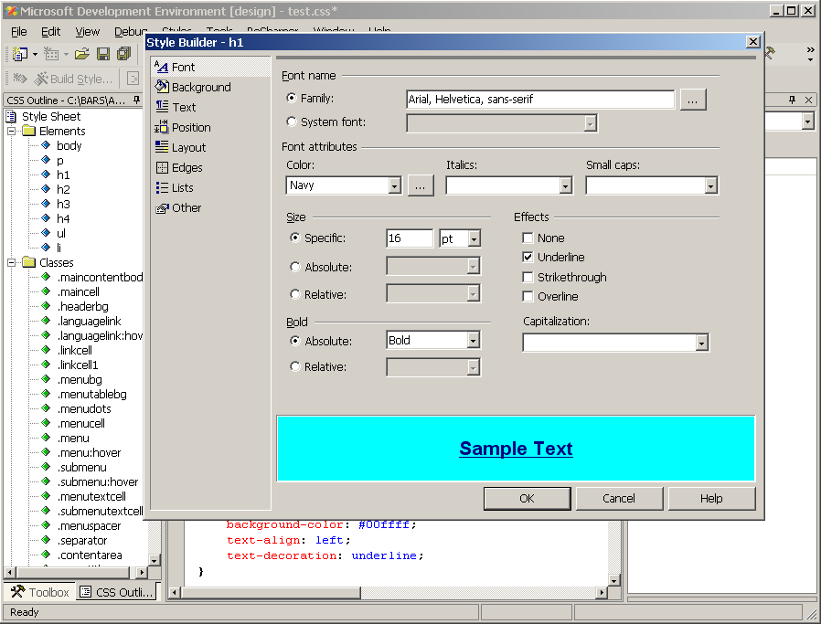
CSS Development Tools
Visual Studio – CSS Editor

Slide 34
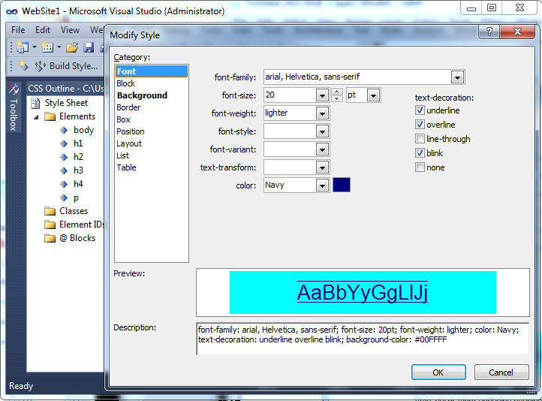
CSS Development Tools (2)
TopStyle Lite 3.1 – Free CSS Tool
http://www.bradsoft.com/download/

Slide 35
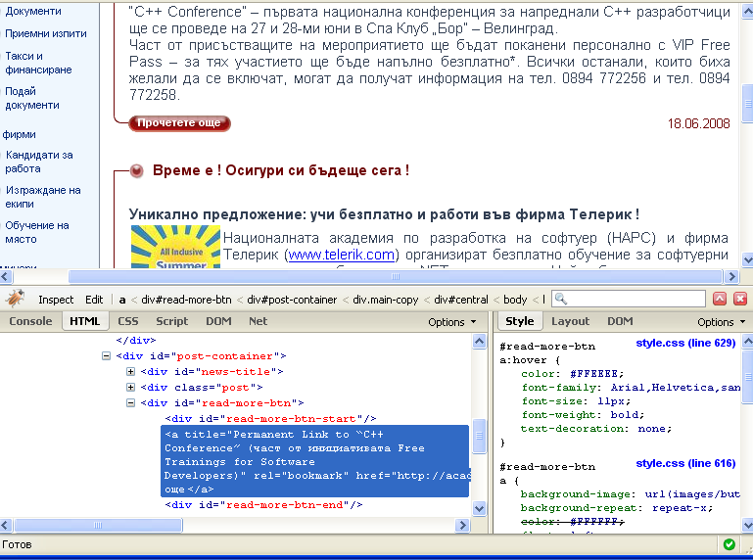
CSS Development Tools (3)
Firebug – add-on to Firefox used to examine and adjust CSS and HTML

Slide 36
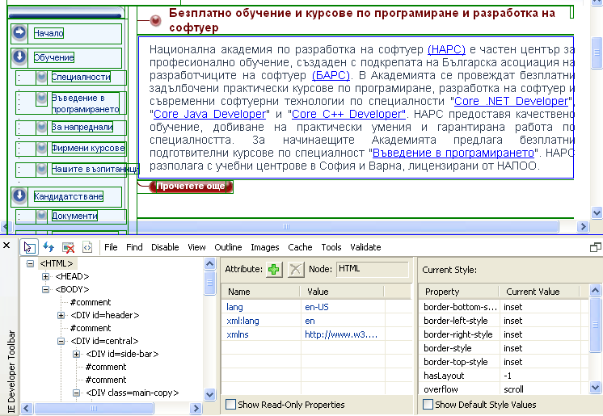
CSS Development Tools (4)
IE Developer Toolbar – add-on to IE used to examine CSS and HTML (press [F12])

Slide 37
CSS Reference
A list of all CSS 2.1 properties is available at http://www.w3.org/TR/CSS2/propidx.html

Slide 38
CSS – Part II
?
?
?
?
?
Questions?
?
?
?
?
?
http://frontendcourse.telerik.com

Slide 39

Exercises
Create the following Web page region using HTML with external CSS file. Note that each program line should be a hyperlink.
Hint: use a definition list (<dl>).

Slide 40

Exercises (2)
Create the following Web page using HTML and external CSS. Using tables, inline styles and deprecated tags is not allowed.

Slide 41
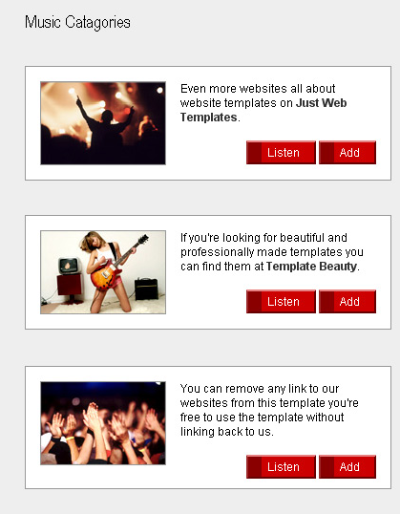
Exercises (3)
Create the following Web page using external CSS styles. Buttons should consist of PNG images with text over them.

Slide 42
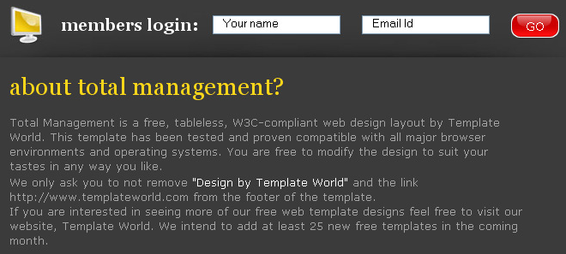
Exercises (4)
Create the following Web page using HTML with external CSS file. Note that the images should be PNG with transparent background.

Slide 43
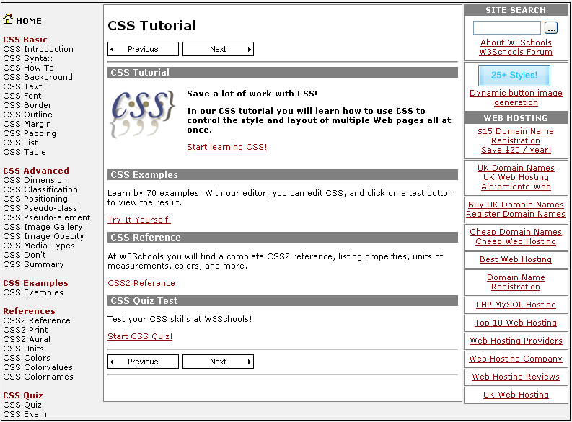
Exercises (5)
Given the picture below (CSS-Web-Site.png) create the Web site. Use CSS and XHTML.

